Slide 1
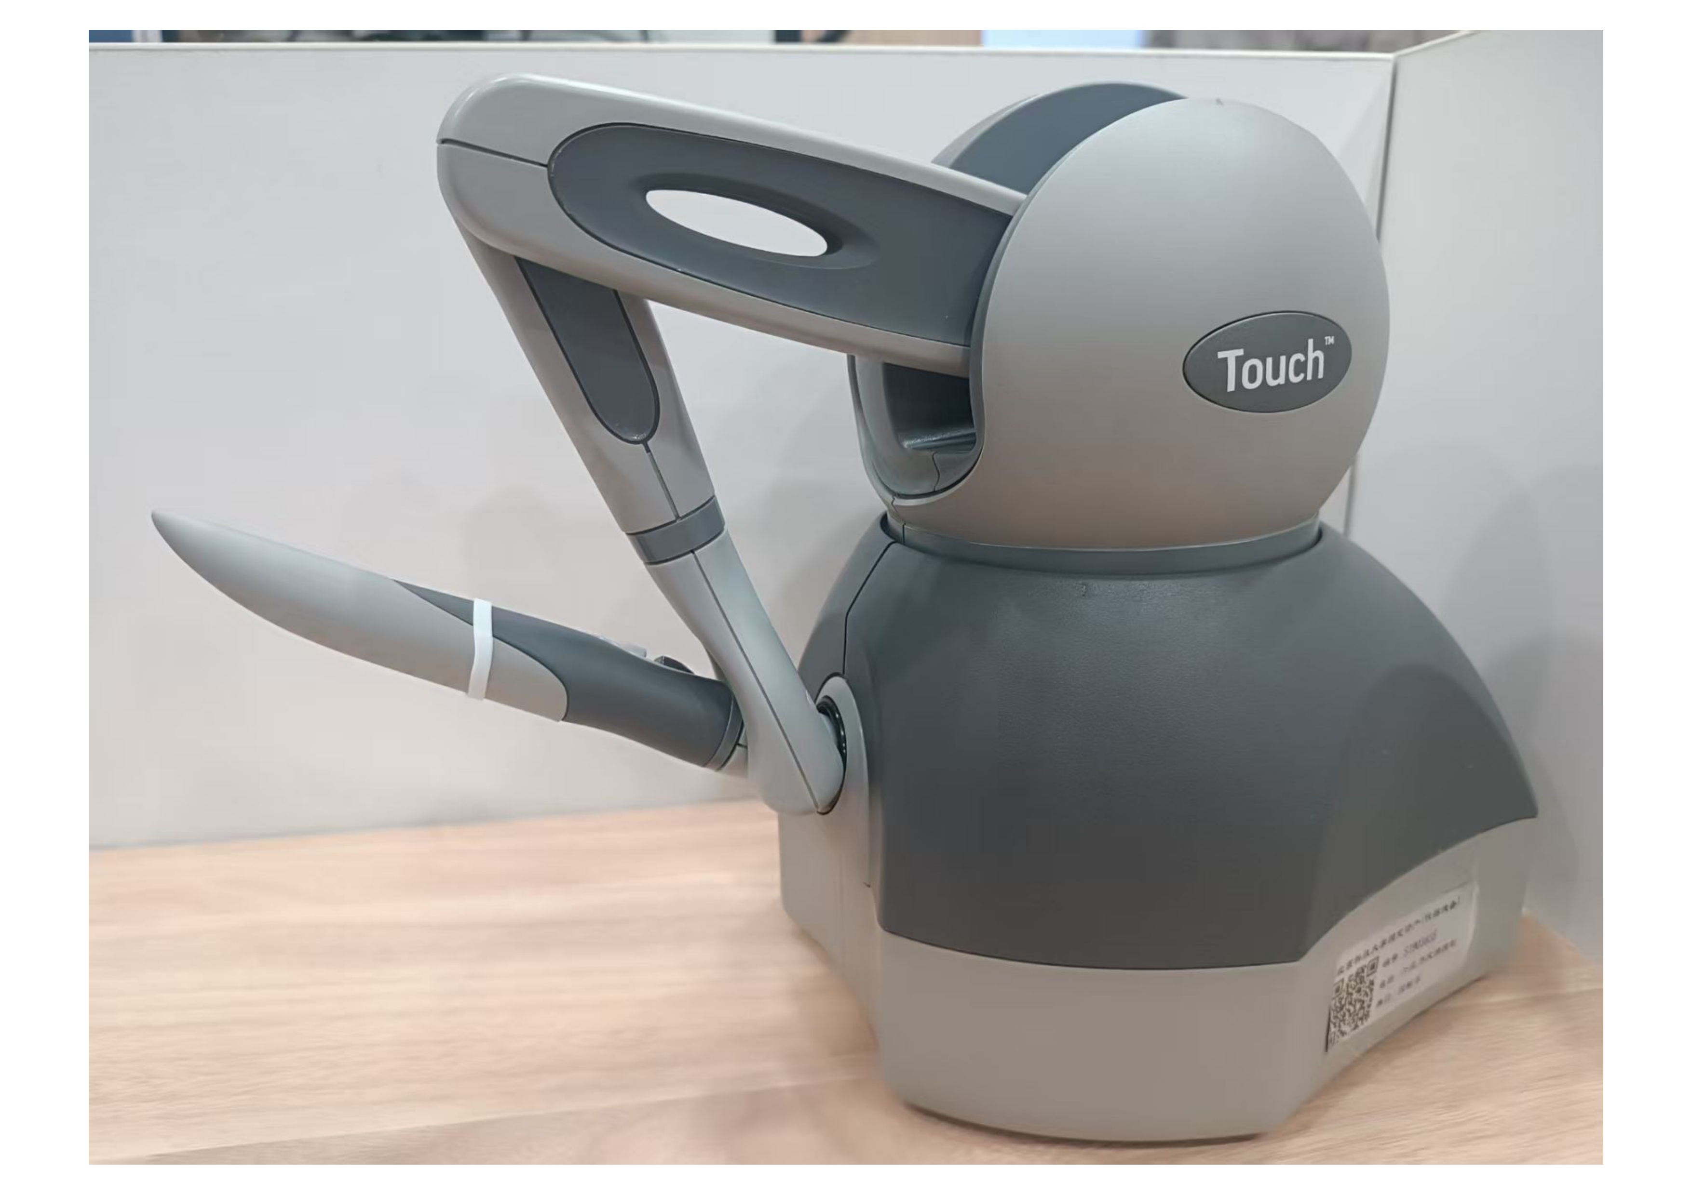
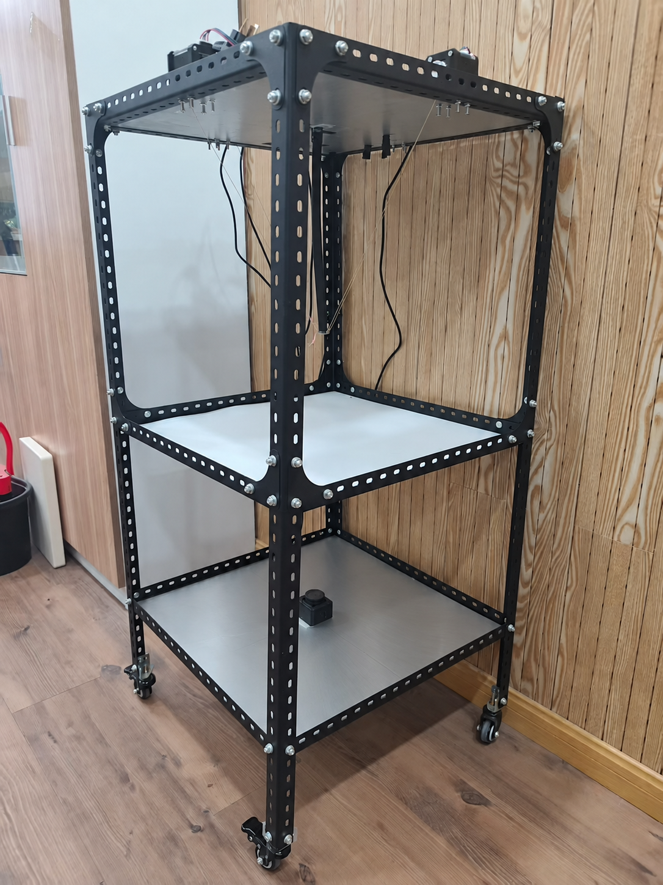
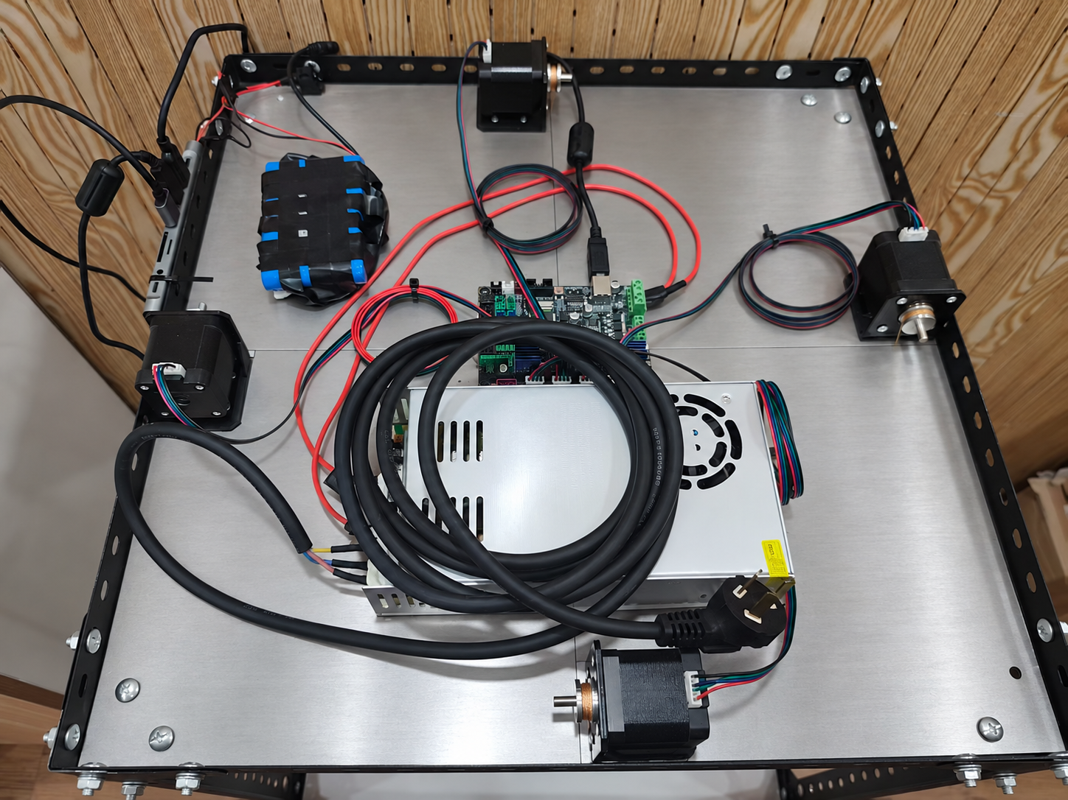
joint 2
joint 3
flexible tube
joint 1
cables
stylus
red laser source
stepper motors
laser power supply
projection plate
controller board
fixed RGB camera
power supply

